Slide 1
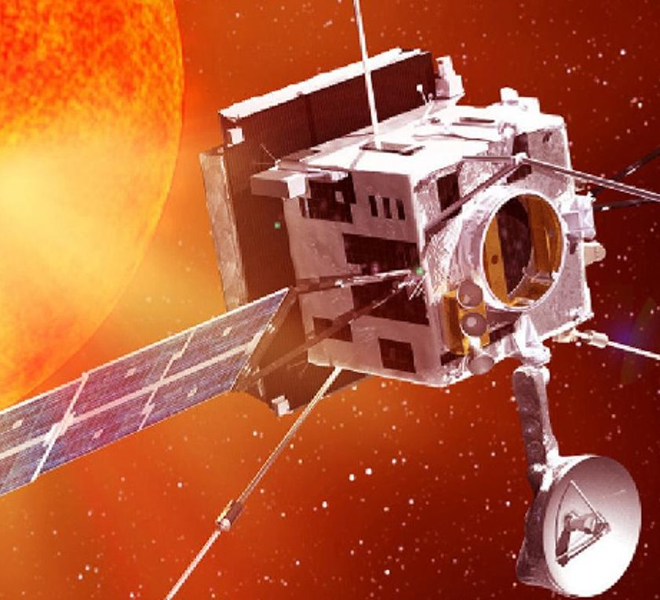
Predictive space Resiliency
Protecting against unexpected malicious exploitation of space systems

Slide 2
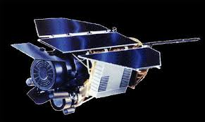
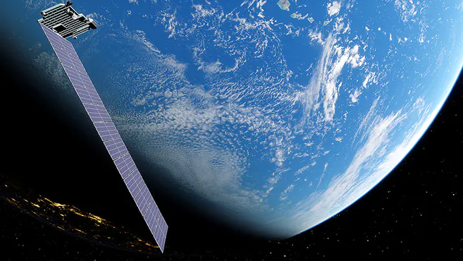
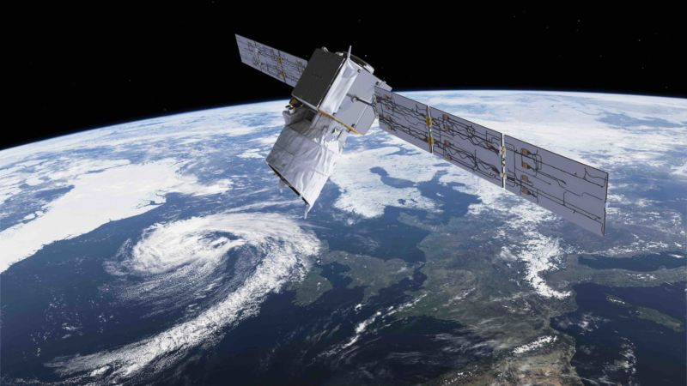
Compromised satellites can be weaponized
Why?
NASA satellite battery fried by hacker aiming solar panels directly at the sun
Starlink near-miss of ESA Aeolus due to "paging system bug"
Collision probability was closer than Starlink initially realized
Centralized paging system highlights need for some level autonomy for

Slide 3
Timeline of number of satellites in orbit
2015
4,077 satellites in orbit
2016
4,256 satellites in orbit
2017
4,635 satellites in orbit
2018
4,857 satellites in orbit
2019
4,987 satellites in orbit
~7,200 satellites in orbit
~11,000 satellites in orbit
~21,000 satellites in orbit
2020
2021
2022
2023
2024
2025
~6,000 satellites in orbit
~8,500 satellites in orbit
~16,000 satellites in orbit
Data gathered from UNOOSA
(United Nations Office for Outer Space Affairs)

Slide 4
Constant onboard prediction
What
Protected satellite runs an always-updating model of other nearby space objects and their capability to collide
Probabilities that exceed acceptable thresholds:
Protected satellite evades
Protected satellite mission transfer

Slide 5
Model capabilities
how
Take known space object position models
Add known/suspected propulsion capabilities
Create constant, real-time probability field of collision potential
User-defined threshold and associated protective actions

Slide 6
Common Good
who
Capability essential for public/private assets alike
Supports US role as protecting space from illicit activity
Overmatch function when coupled with unique US space capabilities (e.g., space radars, communications, etc.)

